Slide 1
Introduction to
Programming Logic & Flow Control

Slide 2

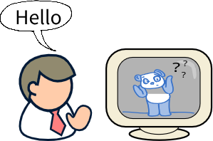
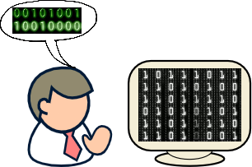
What is a program?
A computer program is the fundamental building block of software development, enabling computers to perform a variety of tasks to provide valuable functionality to users.
In other words, we use programs to communicate with computers in order to give specific instructions to it.

Slide 3
Programming Logic
Systematic process of reasoning and formulating solutions to specific problems.
Breaking down problems into smaller, manageable tasks and creating step-by-step solutions.
Example: You need to write a program to take two numbers from user and show their summation in the output. What would be the steps here?
Take inputs from the user.
Do the calculation to find the sum.
Show the output.

Slide 4
Program Flow Control
Program flow control refers to the order in which instructions are executed within a program based on certain conditions or control structures.
Sometimes, program flow can be sequential.
However, most of the time program, flows are non-sequential.
Program flow can loop back to the previous section of the program.
It is also possible to skip or stop executing certain sections of the program based on some condition.

Slide 5
What is a Flowchart?
Visual representation of a program that uses various shapes, symbols and arrows to explain the sequence or the flow of events.
Few Basic shapes of a flowchart:
Shape | Name | Description
 | Oval | Denotes the Start or the End of a program.
 | Rectangle | Denotes any Calculation that the program must complete.
 | Parallelogram | Denotes Prompt Messages or Input to the program or Output from the program.
 | Circle | This is called the Connector because it is used to combine multiple blocks of code or divide them.
 | Arrow | Illustrates the Flow of a program by merging from one shape to another.

Slide 6
Scenario to Flowchart
START
Prompt “Please Enter a Number”
Let’s go back to the previously discussed scenario and try to visualize it using a flowchart.
Scenario: Think of a program that takes two numbers from the user and shows their summation in the output. Represent this program using a flowchart.
READ num1
Prompt “Please Enter Another Number”
READ num2
sum = num1 + num2
PRINT sum
END

Slide 7
Scenario to Flowchart (Contd)
START
CLASSWORK #1
Scenario: Think of a program that calculates and shows the area of a rectangle after taking the value of its two sides as input. Represent this program using a flowchart.
Prompt “Enter the Value of One Side”
READ X
Prompt “Enter the Value of Other Side”
READ Y
Area = X * Y
PRINT Area
END

Slide 8
Scenario to Flowchart (Contd)
START
CLASSWORK #2
Scenario: Think of a program that calculates and shows the speed of a car in meter/second after getting the speed as kilometer/hour from the user as input. Represent this program using a flowchart.
Prompt “Enter the speed of the car in km/h”
READ car
spd = car * 1000 / 60 * 60
PRINT spd
END

Slide 9
Scenario to Flowchart (Contd)
Visualization
CLASSWORK #3
Scenario: Imagine a rectangle inside of which two circles with radius of R can fit perfectly. Each circle is touching three different sides of the rectangle. Given the value of radius as input, you must calculate and show the area inside the rectangle which is unoccupied by the circles. Represent this program using a flowchart.
Notes:
5

Slide 10
Scenario to Flowchart (Contd)
What we saw in the previous slides was an example of sequential program flow. However, most of the cases program flow are non-sequential. In those scenarios, we use a Diamond shape to decide where the program flow will continue.
Shape | Name | Description
 | Rhombus or Diamond | Denotes a Decision, based on which it is determined that which way the program flow will continue. Even though only one arrow flows into this shape but two arrows comes out of it.

Slide 11
Scenario to Flowchart (Contd)
START
Input A
Let’s check out an example of non sequential program flow.
Scenario: Think of a program that takes two numbers from user and shows the largest number in the output. Represent this program using a flowchart.
Input B
YES
is A > B ?
NO
Print A
Print B
Note: More detail on this in Chapter 7.
END

Slide 12
THANK YOU!

